Slide 1
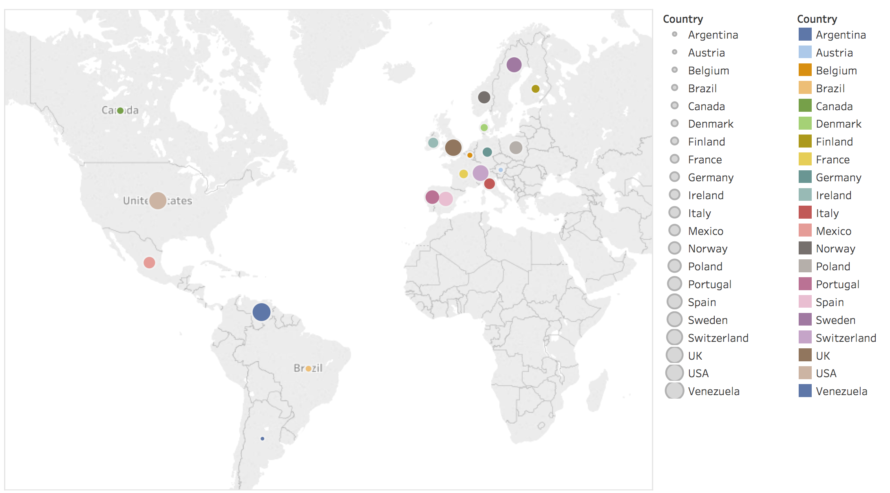
Where are my customers located?
Customers Locations
The map shows the location of our customers. The large the circle is, the large number of customers, and vise versa. The colors are used to enhance the readability.
Notes:
<SQL query>

Slide 2
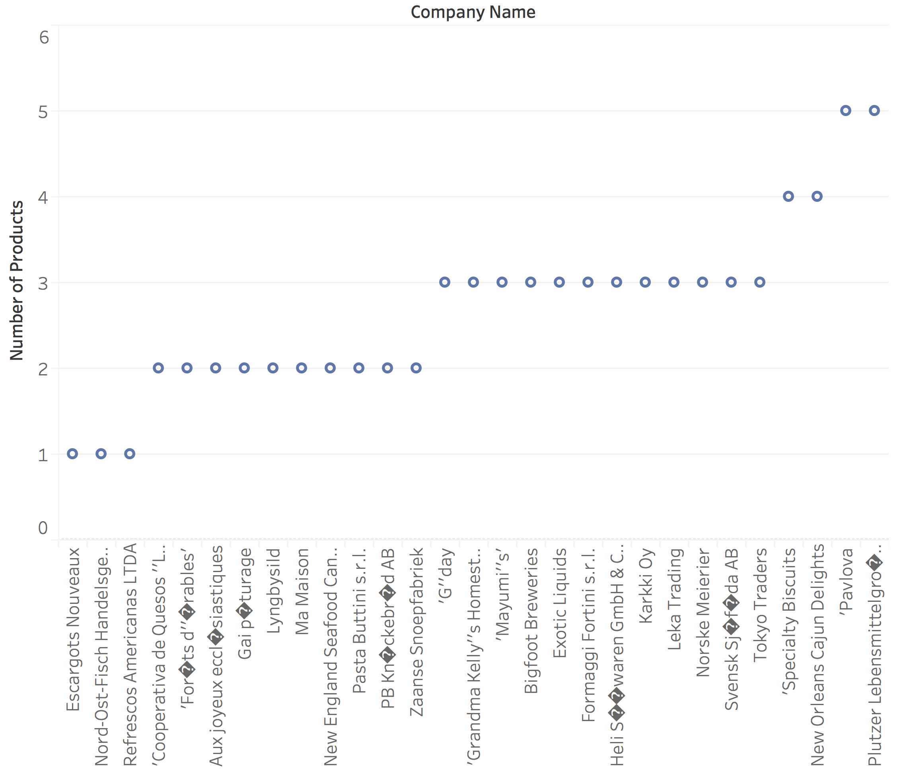
What companies supply the majority of the products I sell?
Products by Suppliers
This visualization displays on the X axis a list of suppliers, and the Y axis shows the number of products for each supplier.
Notes:
<SQL query>

Slide 3
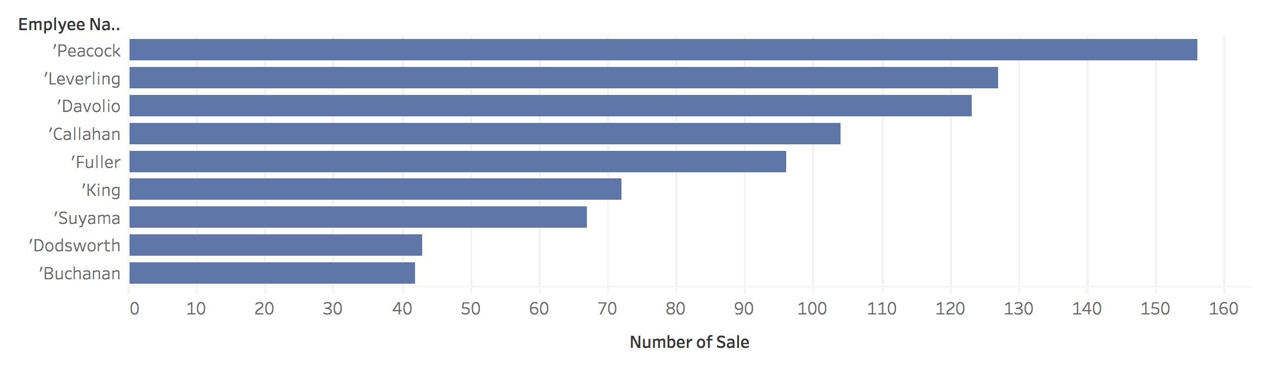
Who are my highest performing employees?
Employees Performance
This visualization displays on the X axis the number of sale that completed with assistance from an employee, and the Y axis shows the names each employee. According to this visualization, the two top employees are Peacock and Leverling.
Notes:
<SQL query>

Slide 4
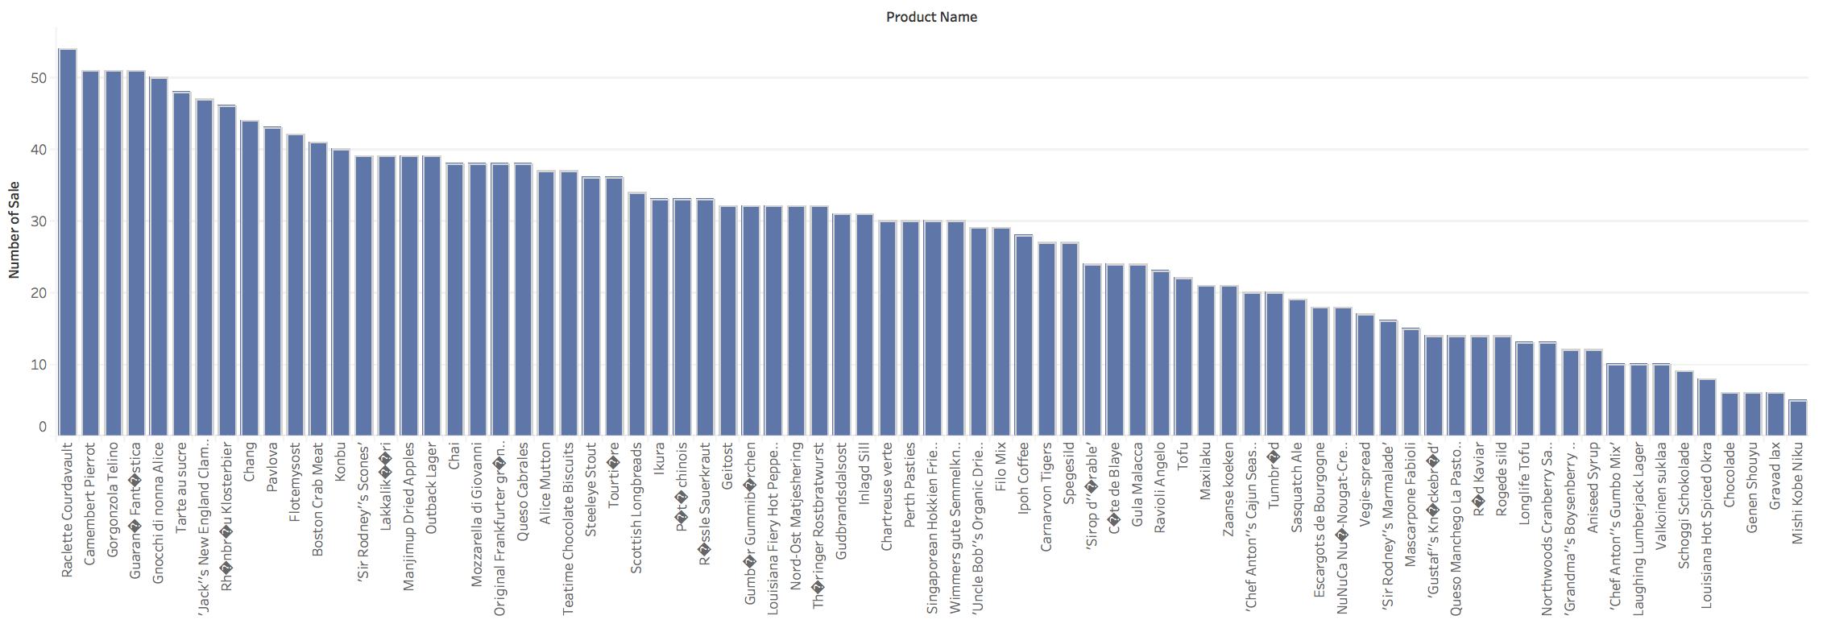
What products are growing in terms of sales?
Growth of Products
This visualization displays on the X axis a list of products, and the Y axis shows the number of sale for each product.
Notes:
<SQL query>

